Slide 1




NATIONAL RESEARCH CENTRE
«KURCHATOV INSTITUTE»
PETERSBURG NUCLEAR PHYSICS INSTITUTE
Russia, 188300, Leningrad District ^{, Gatchina, Orlova Roscha}
EUROPEAN COMMISSION
DIRECTORATE-GENERAL FOR RESEARCH & INNOVATION
Innovation Union and European Research Area
Research infrastructure
Project ‘CREMLINplus’
‘Connecting Russian and European Measures for Largescale Research Infrastructures plus’
Grant 871072
B.P. KONSTANTINOV PETERSBURG NUCLEAR PHYSICS INSTITUTE (PNPI)
NRC “KURCHATOV INSTITUTE”
WG3 PIK collaboration
KICK-OFF CREMLIN Meeting|19-20 February 2020| DESY, Hamburg, Germany

Slide 2
NATIONAL RESEARCH CENTRE
«KURCHATOV INSTITUTE»
PETERSBURG NUCLEAR PHYSICS INSTITUTE
Russia, 188300, Leningrad District ^{, Gatchina, Orlova Roscha}
WP3 Task 3.4:
General blueprint for the instrumentation at PIK
Based on the outcome of the CREMLIN project it was decided that additionally to the national Russian instruments, 5 new neutron instruments will be designed and built in Germany and then installed at the reactor PIK.
Partners will carry out extensive simulation work to define the optimal positioning of both Russian and German instruments on the neutron beams and provide the conceptual design of the neutron blueprint accounting for specific features of the cold sources.
This work will be done under the supervision of the instrumental subcommittees of the PIK-SAC (to be realised within task 3.6) that will provide recommendations aiming maximal complementarity of Russian and international neutron instruments.
KICK-OFF CREMLIN Meeting|19-20 February 2020| DESY, Hamburg, Germany

Slide 3
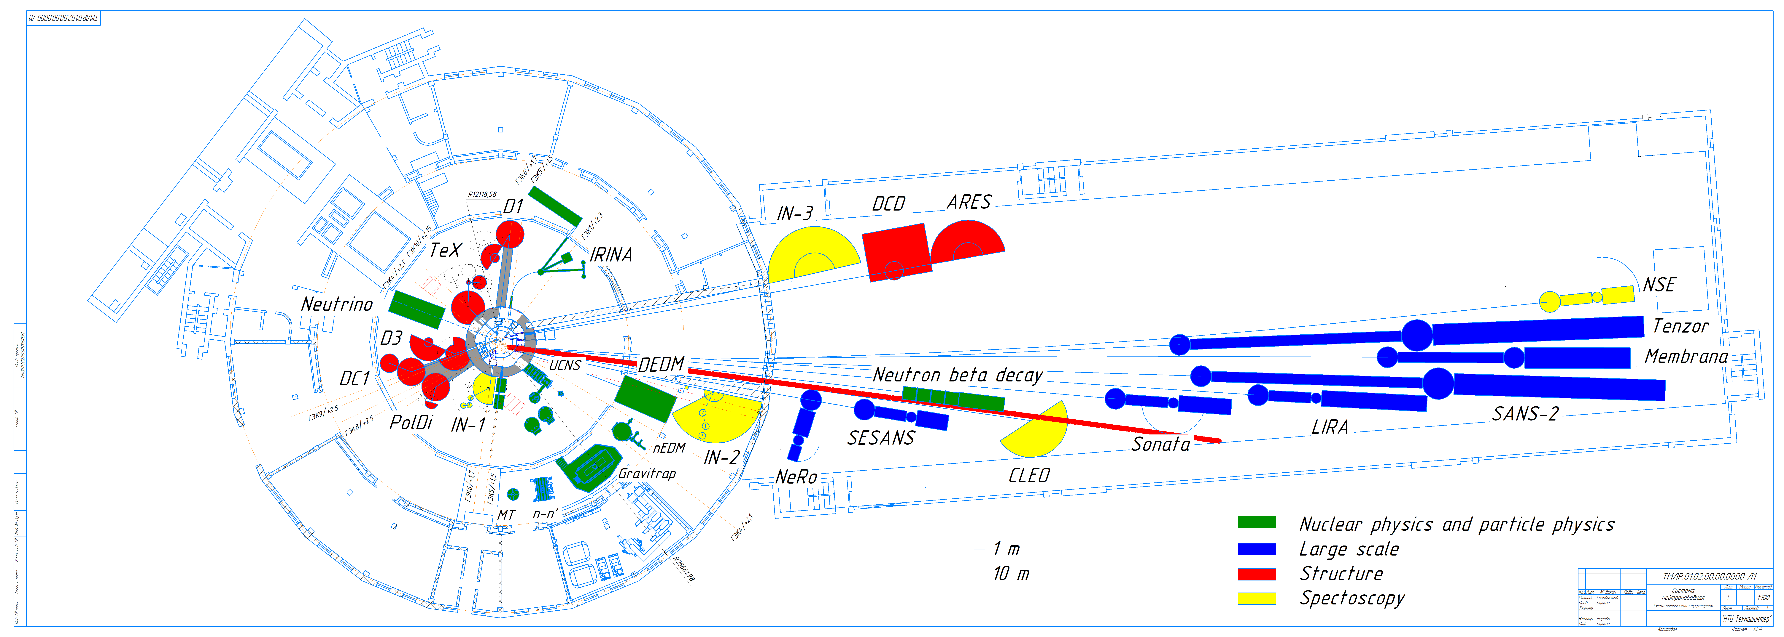
NATIONAL RESEARCH CENTRE
«KURCHATOV INSTITUTE»
PETERSBURG NUCLEAR PHYSICS INSTITUTE
Russia, 188300, Leningrad District ^{, Gatchina, Orlova Roscha}
WP3 Task 3.4:
General blueprint for the instrumentation at PIK
KICK-OFF CREMLIN Meeting|19-20 February 2020| DESY, Hamburg, Germany

Slide 4
NATIONAL RESEARCH CENTRE
«KURCHATOV INSTITUTE»
PETERSBURG NUCLEAR PHYSICS INSTITUTE
Russia, 188300, Leningrad District ^{, Gatchina, Orlova Roscha}
WP3 Task 3.4:
General blueprint for the instrumentation at PIK
01.02.2021 Definition of optimal suite of instruments
01.08.2021 Primary layout of NGs & instruments in the PIK guide hall for optimal instrument suite
Distribution between two cold sources
Build up on already designed part of the NG system (experience and models)
Close link with task 3.1 and 3.2
KICK-OFF CREMLIN Meeting|19-20 February 2020| DESY, Hamburg, Germany

Slide 5
NATIONAL RESEARCH CENTRE
«KURCHATOV INSTITUTE»
PETERSBURG NUCLEAR PHYSICS INSTITUTE
Russia, 188300, Leningrad District ^{, Gatchina, Orlova Roscha}
WP3 Task 3.4:
General blueprint for the instrumentation at PIK
01.08.2022 Design and simulations of neutron guides from high-brilliance source
01.02.2024 Conceptual design & specifications for the guide system from the high-brilliance source
Detailed MC calculations (related to Task 3.7)
Standards?
KICK-OFF CREMLIN Meeting|19-20 February 2020| DESY, Hamburg, Germany

Slide 6
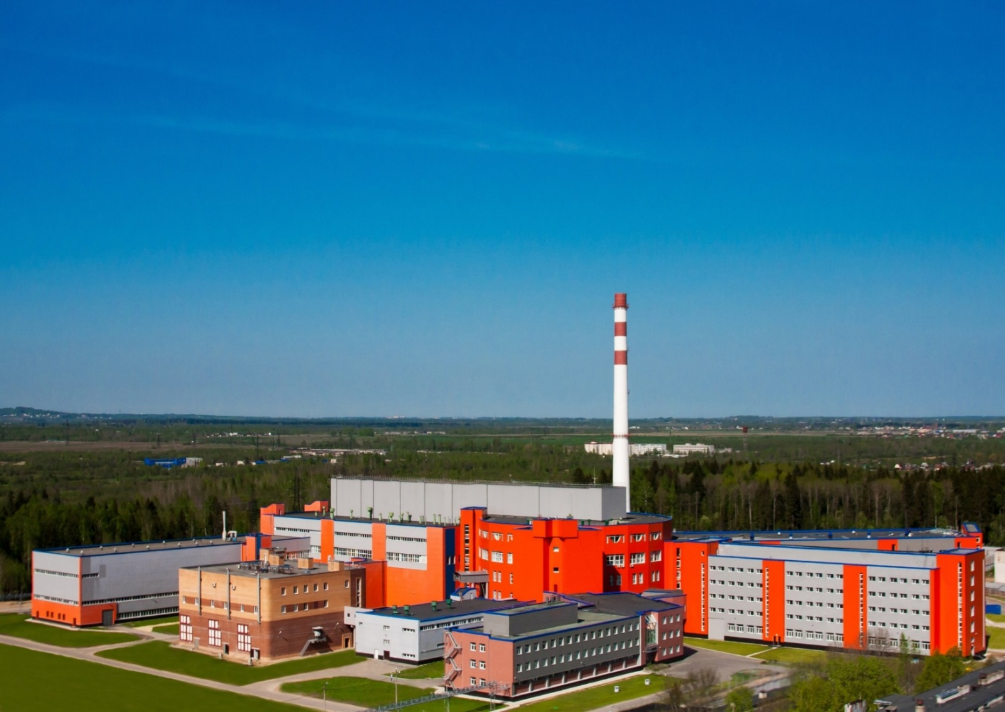
Thank you for your attention!
KICK-OFF CREMLIN Meeting|19-20 February 2020| DESY, Hamburg, Germany

